Slide 1
Managing Chef Recipes

Slide 2
Who the **** are you?!?!
Freddie Rosario
Systems Analyst
Orasi Consultant
Former Google employee
Infrastructure
DevOps
Software Developer

Slide 3
Overview
Environment Setup
Chef concepts
Writing chef recipes
Extending chef recipes with ruby
Running Chef code
Notes:
Environment setup is just an overview.
Not actually doing it until the lab

Slide 4
Environment Setup
RVM (Optional but recommended)
Ruby
Rubygems
Chef gem
Notes:
Ruby Version Manager
Show http://rvm.io/ web page
Installs ruby and rubygems for you
With rubygems install simple chef gem install
Alternate: http://www.getchef.com/chef/install/

Slide 5
Basic Concepts
http://docs.opscode.com/
Resources
Libraries
Recipes
Cookbooks
Notes:
Wealth of documentation at this url

Slide 6
Chef Resources
Defines an action
Run in order written
Piece of the system and desired state
directory "/tmp/folder" do
owner "root"
group "root"
mode 0755
action :create
end
Notes:
Examples of actions:
Create a file or directory
Start a service
Create a user
Typical resource format:
attribute value
action :type_of_action

Slide 7
Chef Recipes
Ruby syntax
Collection of resources
May include other recipes as it runs

Slide 8
Chef Recipe Example
directory "/tmp/folder" do
owner "root"
group "root"
mode “0755”
action :create
end
file "/tmp/folder/important.file" do
owner "root"
group "root"
mode "0755"
action :create
end

Slide 9
Chef Cookbooks
Defines a scenario
Collection of recipes
Includes everything needed
Notes:
Examples of scenarios:
Install a mysql server
Create accounts for new employees
Setup laptop with necessary tools for new employees

Slide 10
Custom Chef Libraries
Extends chef classes
Written in Ruby
Allows for full use of Ruby
Notes:
Example: Wrote library to check for internet access through proxy server
Full use:
For loops
Using third party modules
Direct system calls

Slide 11
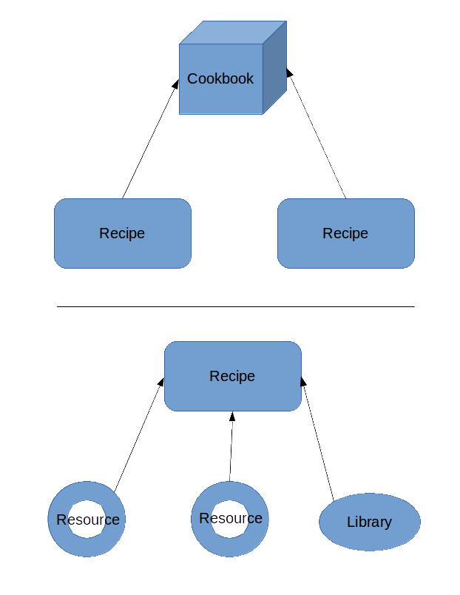
Organization of Chef Code
(Simplified)
Notes:
Multiple resources and any relevant libraries are logically grouped into a recipe:
A user recipe may create login account, and home directories
Multiple related recipes are grouped into a cookbook to achieve a scenario:
MySQL database cookbook may:
Have a recipe for installing server
Configuring firewall
Creating database user accounts

Slide 12
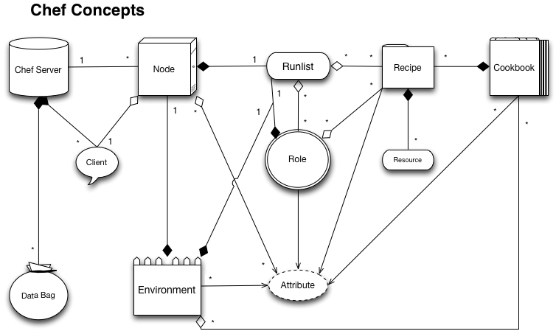
Borrowed from opscode wiki

Slide 13
Useful Links
Ruby official website:
https://www.ruby-lang.org
Ruby Version Manager:
http://rvm.io/
Chef documentation
http://docs.opscode.com/

Slide 14
Conclusion
Questions?

